Slide 1


Big Mountain Resort
Market Analysis & Price Recommendations.

Slide 2

Problem Select a better value for ticket price which capitalizes on facilities instead of market average.
Big Mountain Resort Key Facts
Spectacular views of Glacier National Park and Flathead National Forest
105 trails
11 lifts
2 T-bars
1 magic carpet for novice skiers.
3.3 mile longest run.
Base elevation 4,464 ft,
Summit 6,817 ft
Vertical drop of 2,353 ft.
350,000 visitors
Accommodate skiers and riders of all levels and abilities.

Slide 3
Recommendation Model predicts a ticket price of $95.87 with a mean absolute error of. $10.39. It suggests there is room for an increase.
Key Findings
Features that matter:
Customers are more likely to pay more for these features:
Vertical Drop
Snow Making Area
Chairs
Fast Quads
Runs
Longest Run
Trams
Skiable Area
Data analysis shows that Big Mountain exceeds in most features in its market segment.
Proposals with most potential:
Close top 1 unused run. Model says closing one run makes no difference.
Increase vertical drop 150 feet and install additional chair lift. This scenario increases support for ticket price by $1.99 and over the season this could be expected to amount to $3474638.00

Slide 4
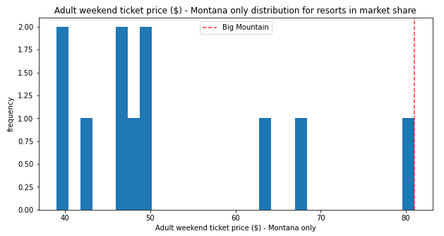
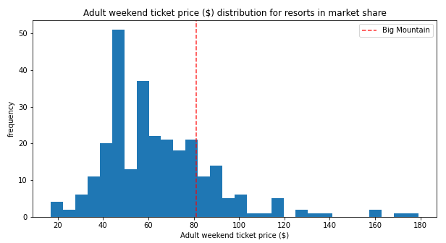
Ticket Prices for Big Mountain Resort compared with the market segment

Slide 5
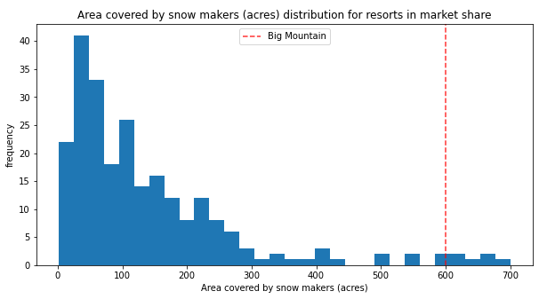
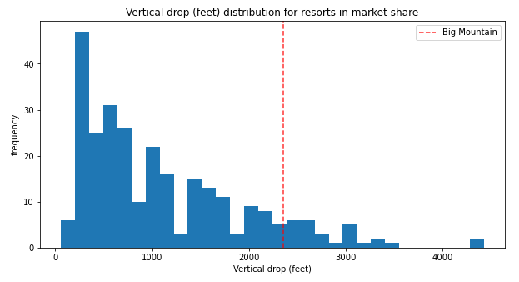
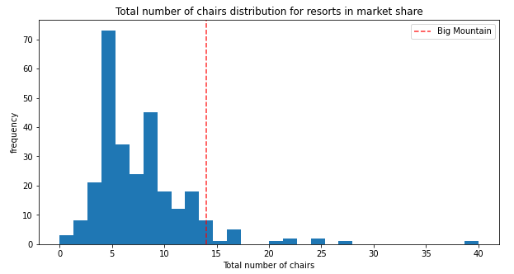
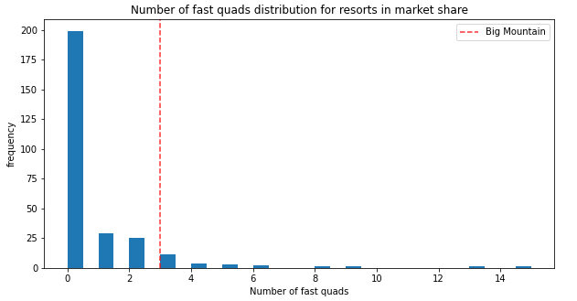

Slide 6
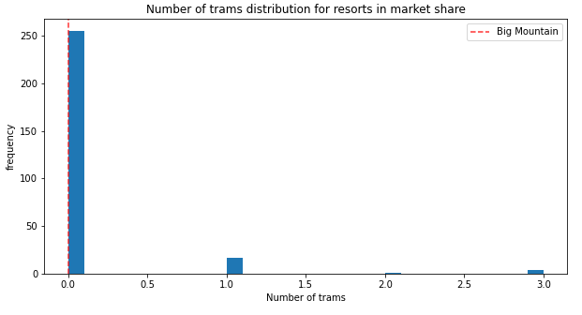
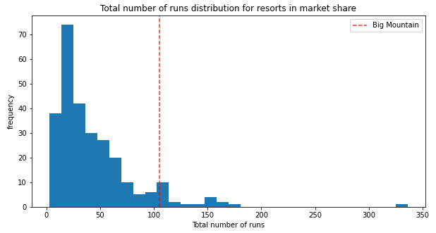
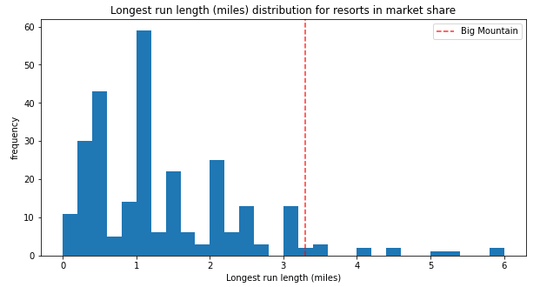
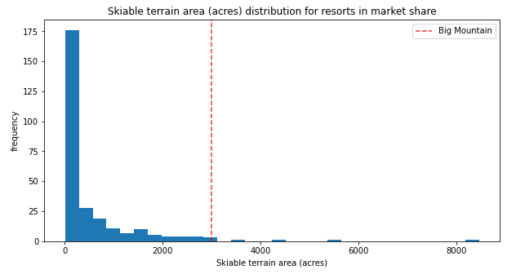

Slide 7
Model predictions for various proposals:
Close top 10 unused runs. Model says closing one run makes no difference. Closing 2 and 3 successively reduces support for ticket price and so revenue. If Big Mountain closes down 3 runs, it seems they may as well close down 4 or 5 as there's no further loss in ticket price. Increasing the closures down to 6 or more leads to a large drop.
Increase vertical drop by 150 feet and install an additional chair lift. In this scenario, Big Mountain is adding a run, increasing the vertical drop by 150 feet, and installing an additional chair lift. This scenario increases support for ticket price by $1.99 and over the season this could be expected to amount to $3474638.
Increase vertical drop by 150 feet and install an additional chair lift and add 2 acres of snow making capability. This scenario increases support for ticket price by $1.99 and over the season this could be expected to amount to $3474638. This is similar to scenario 2 so there is no effect of adding extra 2 acres of snow making capability.
Increase longest run by 0.2 miles and guaranteeing its snow coverage by adding 4 acres of snow making capability. This scenario does not support any increase in ticket price.

Slide 8


Summary
Model predicts a ticket price of $95.87 with a mean absolute error of. $10.39. It suggests there is room for an increase.
Other Proposals to consider:
Close top 1 unused run. Model says closing one run makes no difference.
Increase vertical drop 150 feet and install additional chair lift. This scenario increases support for ticket price by $1.99 and over the season this could be expected to amount to $3474638.00

